Slide 1
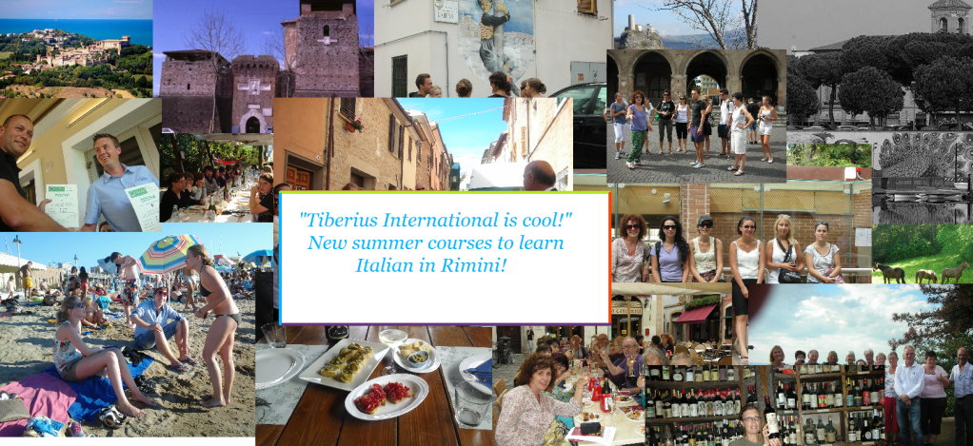
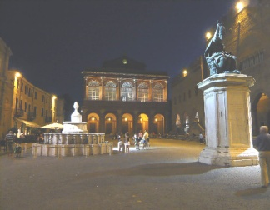
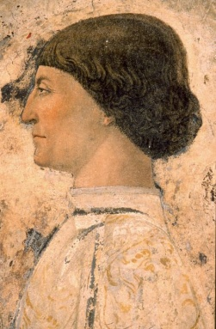
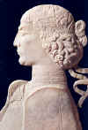
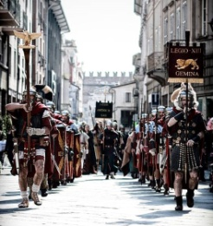
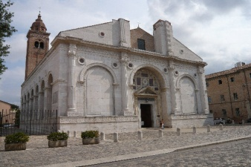
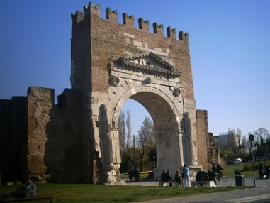
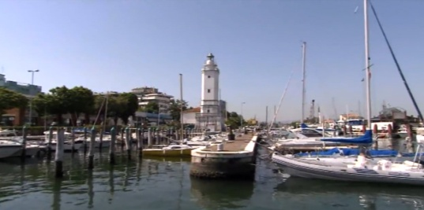
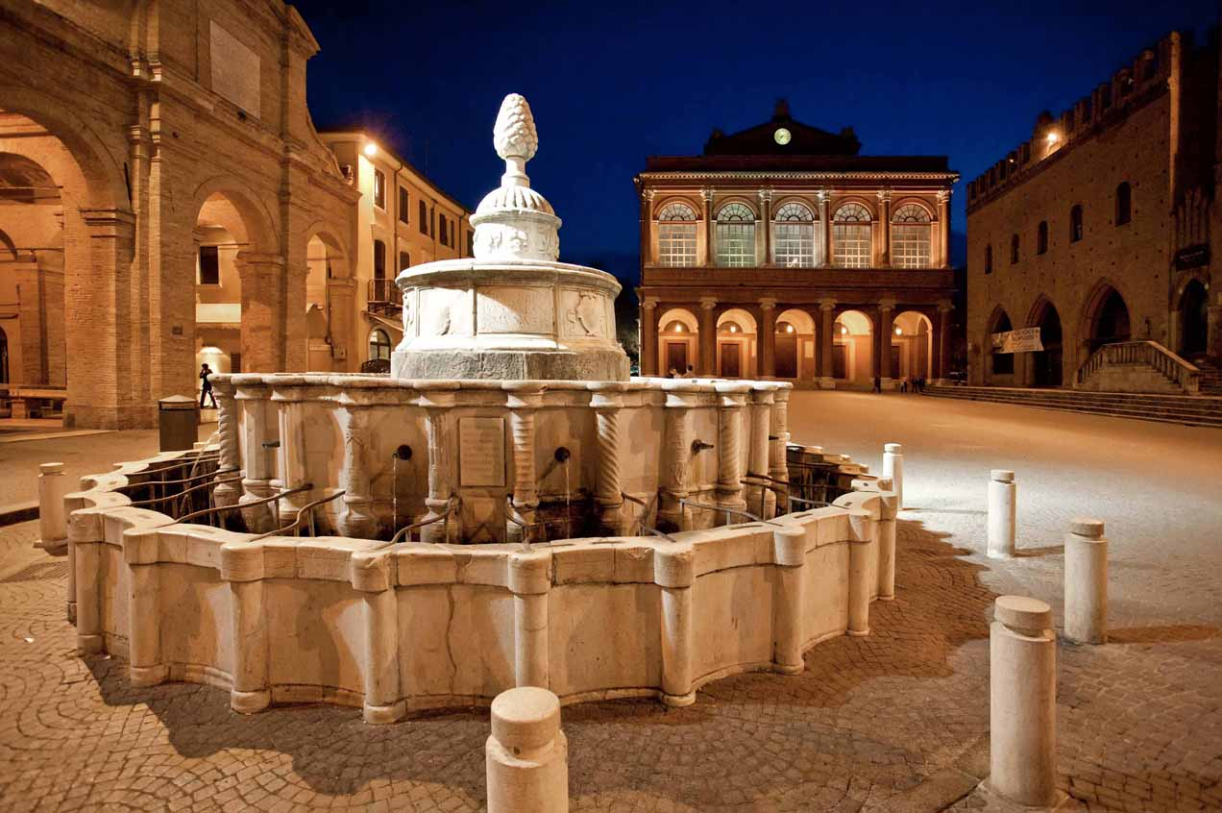
Tiberius International School
Rimini City of Art and Culture
The city and the surrounding lands are rich in hidden jewels of art, culture and history, splendid tokens of an important past

Slide 2
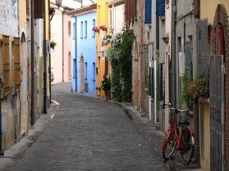
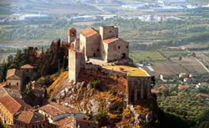
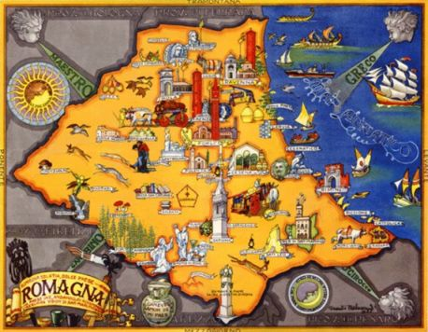
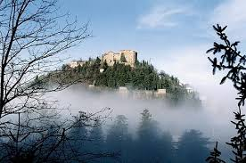
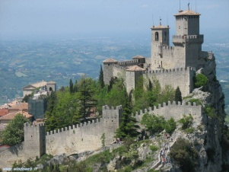
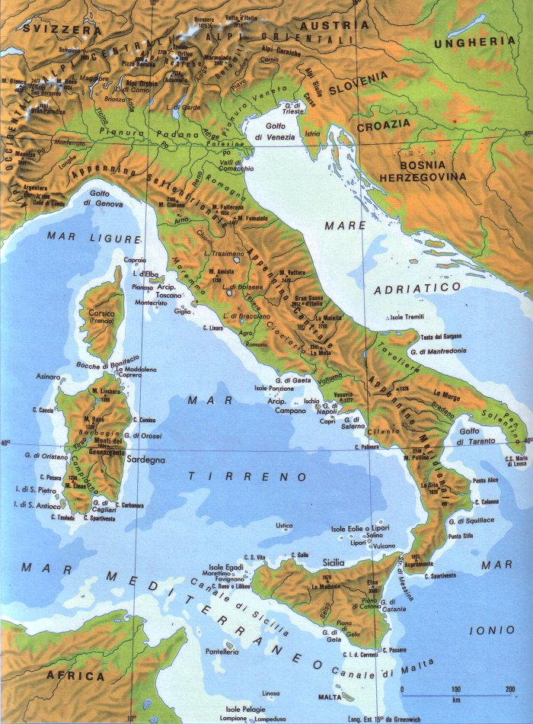
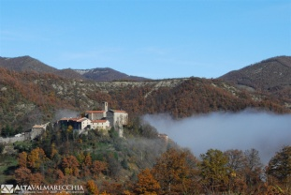
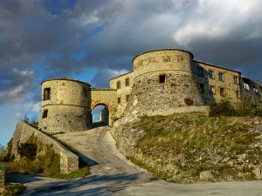
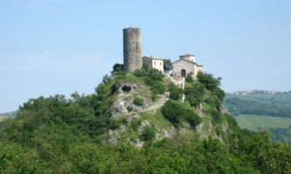
Rimini Piazza Cavour
Tiberius International
info@tiberius-international.com
www.tiberius-international.com
That’s ROMAGNA

Slide 3
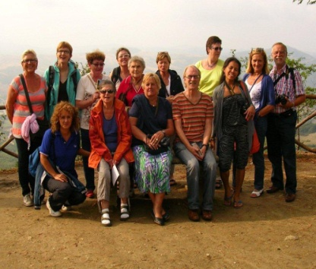
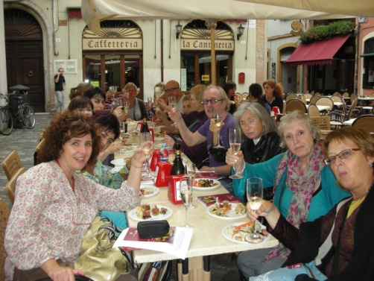
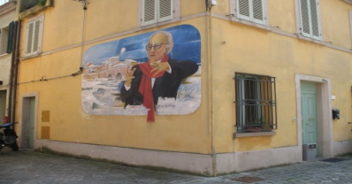
Language/cultural trips in Italy made in TIBERIUS
Language holidays to discover Romagna a path dedicated to lovers of the language, traditions, habits and customs. Sought passages in places where you can discover the "Italian life" and its history. An original journey that will leave the imprint of a rewarding experience
Rimini was founded by the Romans in 268B.C., on the site of a former Etruscan
settlement , as a bridgehead for the conquest of northern Italy ans a mayor port
of the upper Adriatic Sea. The city still keeps its original urban layout.

Slide 4
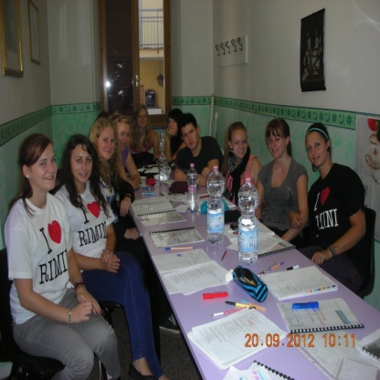
Standard Courses
GROUP COURSES PRICES 2018
annual enrolment fee € 50,00
COURSES HOURS 1 WEEK 2 WEEKS 3 WEEKS 4 WEEKS extra week
Standard Course (CS) 20 € 250 € 380 € 450 € 560 € 150
_Intensive standard course 20+5 € 360 € 600 € 780 € 1000 € 260
__________________________________________________________________________________________
Combined Course A
CC2 Italian Cinema 20 +10 € 450 € 750 € 1.050 € 1.350 € 250
CC3 history of art 20 +10 € 450 € 750 € 1.050 € 1.350
CC4 history of Italian fashion 20 +10 € 450 € 750 € 1.050 € 1.350
CC10 conversation 20 +10 € 450 € 750 € 1.050 € 1.350
CC11 grammar 20 +10 € 450 € 750 € 1.050 € 1.350
Combined Course B
CC5 commercial writing 20 +10 € 550 € 980 € 1.400 € 1.880 € 300
CC6 commerce and economy 20 +10 € 550 € 980 € 1.400 € 1.880
CC7 hotel e tourism 20 +10 € 550 € 980 € 1.400 € 1.880
CC8 banking language 20 +10 € 550 € 980 € 1.400 € 1.880
CC9 international rights and la 20 +10 € 550 € 980 € 1.400 € 1.880

Slide 5
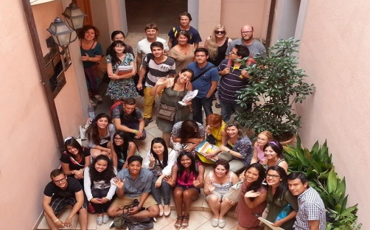
Special Courses
COURSES HOURS 1 WEEK 2 WEEKS 3 WEEKS 4 WEEKS extra week
cum Tiberius Latine loqui 20 +10 € 456 € 850 € 1.200 € 1.350
for singer Opera vocal 20 + 2* -------- € 800 € 1.000 € 1.200 € 300
phonetics 20 for groups - for more details ask to secretary
cooking lessons 20 + 2** € 450 € 800 € 1000 € 1.200
mini courses :
MC1 grammar
MC2 conversation 10 € 180 € 280 € 330 € 450
MC3 written expressions
Talking and Walking conversation with a Tutor € 40 (90 minutes) for more details ask to secretary
CSN Sweden 13 weeks € 1.400 for more details ask to secretary
Long term courses HOURS PER 8 WEEKS 12 WEEKS 24 WEEKS 48 WEEKS
CS Plus 20 € 980 € 1.390 € 2.790 € 5.200
* two individual lessons per week with “Maestro” ** two practical lessons per weeks
Prices include: placement test- teaching material- periodic performance test - final test- Diploma / attendance certificate- guided tour of the city- certificates for Studio Visa – free WIFI in school

Slide 6
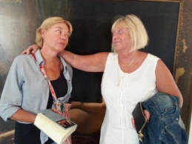
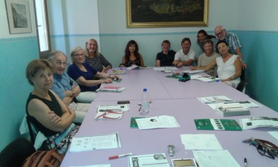
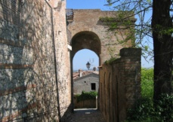
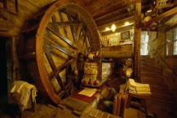
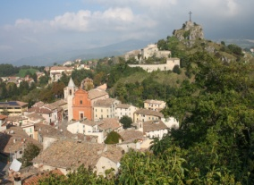
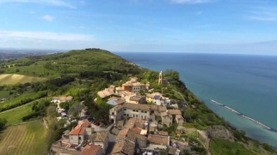
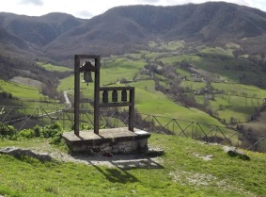
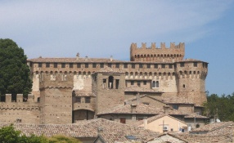
COURSE OVER 50s
20 hours of lessons from 9 a.m to 13 p.m. of which: 1 lesson in local cuisine and 1 lesson in art history
Teaching materials ***Placement test and final test ***Certificate of participation
Afternoon activities : °°guided tour of the historic part of the city with a “Welcome drink”
excursion to the village of Santarcangelo
visit to the medieval center, to the caves and to mangano
°°excursion to Fiorenzuola di Focara, the country over the sea and the Castle Gradara
°°excursions in Pennabilli and Tibetan bells.

Slide 7
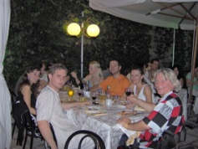
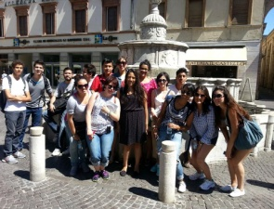
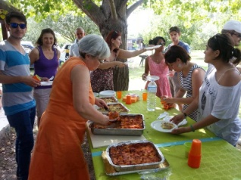
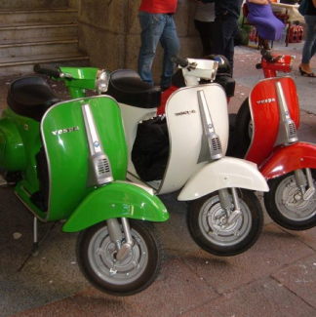
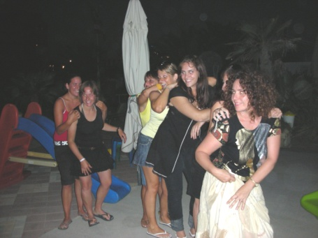
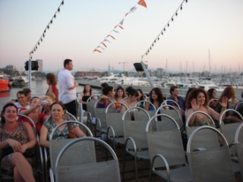
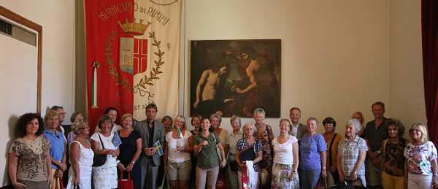
Free time
True lessons of Italian lifestyle and amusement even in the afternoon and in the evening following our weekly offer:
Welcome dinner
Old town guided tour
Beach party
Theme party
Disco e Pub
Cruises (day and night)
Sports
Beach and sea !!

Slide 8
6 levels of knowledge
The CEFR: transparent, coherent and comprehensive
The result of over twenty years of research, the Common European Framework of Reference for Languages: Learning, teaching, assessment (CEFR) is exactly what its title says it is: a framework of reference. It was designed to provide a transparent, coherent and comprehensive basis for the elaboration of language syllabuses and curriculum guidelines, the design of teaching and learning materials, and the assessment of foreign language proficiency. It is used in Europe but also in other continents and is now available in 40 languages.
Six levels of foreign language proficiency
The CEFR describes foreign language proficiency at six levels: A1 and A2, B1 and B2, C1 and C2. It also defines three ‘plus’ levels (A2+, B1+, B2+). Based on empirical research and widespread consultation, this scheme makes it possible to compare tests and examinations across languages and national boundaries (see the section “The CEFR and language examinations: a toolkit”). It also provides a basis for recognising language qualifications and thus facilitating educational and occupational mobility.
The CEFR’s illustrative scales of “can do” descriptors are available in a bank of descriptors together with many other related descriptors.

Slide 9
Level group
A Basic user
A1
Breakthrough or beginner
Can understand and use familiar everyday expressions and very basic phrases aimed at the satisfaction of needs of a concrete type.
Can introduce themselves and others and can ask and answer questions about personal details such as where he/she lives, people they know and things they have.
Can interact in a simple way provided the other person talks slowly and clearly and is prepared to help.
A2
Way stage or elementary
Can understand sentences and frequently used expressions related to areas of most immediate relevance (e.g. very basic personal and family information, shopping, local geography, employment).
Can communicate in simple and routine tasks requiring a simple and direct exchange of information on familiar and routine matters.
Can describe in simple terms aspects of their background, immediate environment and matters in areas of immediate need.
B Independent user
B1
Threshold or intermediate
Can understand the main points of clear standard input on familiar matters regularly encountered in work, school, leisure, etc.
Can deal with most situations likely to arise while travelling in an area where the language is spoken.
Can produce simple connected text on topics that are familiar or of personal interest.
Can describe experiences and events, dreams, hopes and ambitions and briefly give reasons and explanations for opinions and plans.
B2
Vantage or upper intermediate
Can understand the main ideas of complex text on both concrete and abstract topics, including technical discussions in their field of specialization.
Can interact with a degree of fluency and spontaneity that makes regular interaction with native speakers quite possible without strain for either party.
Can produce clear, detailed text on a wide range of subjects and explain a viewpoint on a topical issue giving the advantages and disadvantages of various options.
C Proficient user
C1
Effective operational proficiency or advanced
Can understand a wide range of demanding, longer clauses, and recognize implicit meaning.
Can express ideas fluently and spontaneously without much obvious searching for expressions.
Can use language flexibly and effectively for social, academic and professional purposes.
Can produce clear, well-structured, detailed text on complex subjects, showing controlled use of organizational patterns, connectors and cohesive devices.
C2
Mastery or proficiency
Can understand with ease virtually everything heard or read.
Can summarize information from different spoken and written sources, reconstructing arguments and accounts in a coherent presentation.
Can express themselves spontaneously, very fluently and precisely, differentiating finer shades of meaning even in the most complex situations.

Slide 10
School.tiberius
Tiberius International
 | OFFICIALLY AUTHORISED BY ITALIAN MINISTRY OF EDUCATION Prot. num. 19829 Decreto n. 170/UFF. III
info@tiberius-international.com
++39-541-23292/329-7711905
DITALS University of Siena
Notes:
School.tiberius

