Slide 1
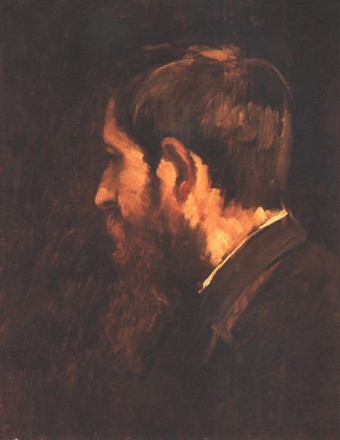
Life and Work of László Paál
Created by: Péter Kurucz

Slide 2
László Paál’s life
Paál László was born in Zám in Hunyad county, in the 19th century on 30th July in 1846. His dad was a postmaster, and his mother was Lujza Fülöp, she was László Nopcsa’s daughter. László had a sister her name was Berta, and a brother, his name was Gyula they were twins.
He studied in a drawing school in Arad. His first teacher was Péter Nagy, Peter was a famous painter, later he studied at Pál Böhm’s drawing school.
In 1862 he met Mihály Munkácsy, he found a good friend and the teacher of his life in Munkácsy.
In 1864 he studied at the university of law in Vienna.
In 1866 he studied at the Academy of Fine Arts in Vienna. His teacher was Albert Zimmermann.
In the autumn of 1872 he moved to Paris, but in summer he lived in Barbizon near Paris, in the forest of Fontainebleau.
In 1877 he had brain injury, in 1878 he lived in a sanatorium of Charenton-le-pont.
He died on third of March in 1879 at midnight.

Slide 3
The work of László Paál
He is one of the most important Hungarian landscape painters. His work helped to make this kind of painting popular. In the earlier paintings he used dark colours, and he played with the light and shadow.Paál and Munkácsy liked the 17th century painters of the Netherlands, for example, Franz Hals and Rembrandt.
Paál studied the landscape paintings of John Constable, after that he used lighter colours, and he also painted some watercolours, following the example of the English watercolour painters.
Paál’s name and art became famous after his life work exhibition in the National Exhibition Room in 1902.
In 1923 they founded the László Paál Association in honour of him. The members of this assoiciation are maindly landscape painters.

Slide 4
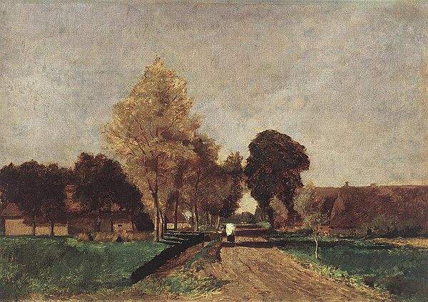
Paál László: Dél (Noon)
He made it in 1870 with oil, in the drawing there are trees, this is a landscape, Size:36,5×53,5 cm This painting is in the Hungarian National Gallery in Budapest.

Slide 5
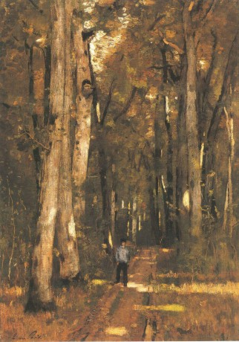
Paál László: Út a fontainebleau-i erdőben (Path in the forest of Fontainebleau)
He made it in1876, with oil, Size:91,5×63 cm, this painting is in the Hungarian National Gallery in Budapest.

Slide 6
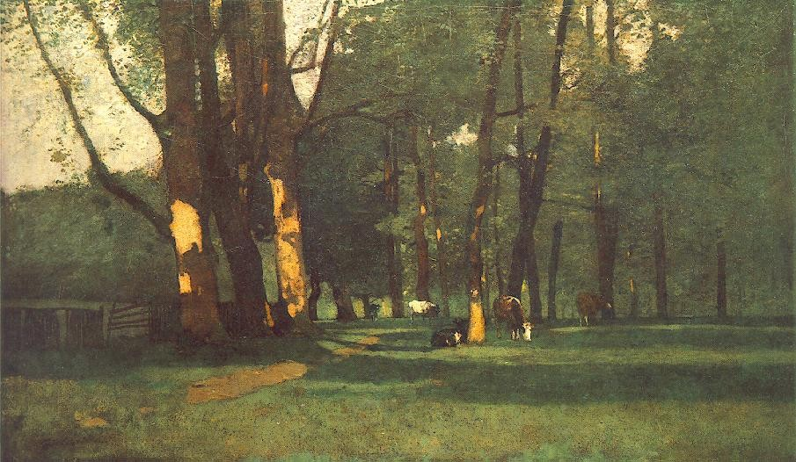
Paál László: Tehenek a fák alatt (Cows under the trees)
He made it in1872, with oil,
Size78×132 cm, this painting is in the Hungarian National Gallery in Budapest.

Slide 7
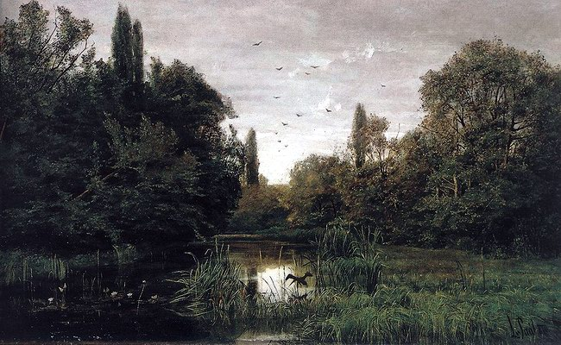
Paál László Békák mocsara (Swamp of the frogs)
He made it in1875, with oil,
Size:63×92 cm, this painting is in the Hungarian National Gallery in Budapest.

Slide 8
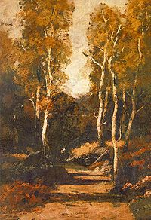
Paál László: Erdei út (Path in the forest)
1876, oil painting on canvas, 65×46 cm, it is in the Hungarian National Gallery in Budapest

Slide 9
Thank you!

Slide 10
2011-2013.
„Forest fancy Facebook” Comenius project of Debreceni Csokonai Vitéz Mihály Gimnázium, Hungary
and Viinijärven koulu, Finland

